Slide 1

Experiences

Slide 2
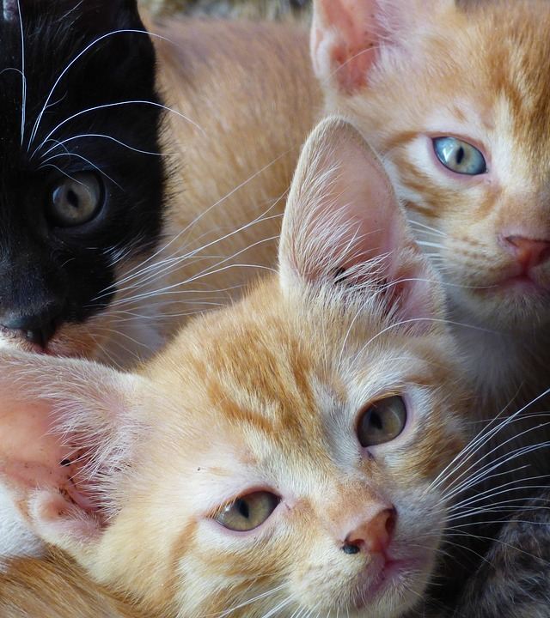
Today’s Class
Connecting the Dots
Potential IB Questions
Introduction to Anorexia Nervosa
Articles
Discussion

Slide 3
Connect the Dots
IB Themes
1. Identities
2. Experience
3. Human Ingenuity
4. Social Organization
5. Sharing the Planet
Internal Assessment
Part 3
Open conversation about
one of the themes.

Slide 4
Questions to Expect
1. How can we extend sympathy to experiences we may not be able to relate to?
2. What can we learn from the experiences of others?

Slide 5
Sympathy vs. Empathy
Notes:
Rules for the WeChat group.

Slide 6
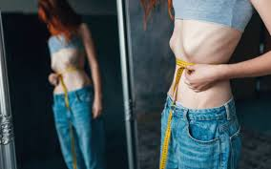
Anorexia Nervosa

Slide 7
What is Anorexia Nervosa?
A severe mental health disorder characterized by an obsessive fear of weight gain and a distorted body image.
Leads to extreme food restriction and excessive weight loss.

Slide 8
Key Characteristics of Anorexia Nervosa
Symptoms:
Intense fear of gaining weight
Distorted body perception
Restrictive eating patterns
Extreme weight loss
Over-exercising

Slide 9
Causes and Risk Factors
Biological Factors:
Genetic predisposition
Neurobiological changes

Slide 10
Causes and Risk Factors
Psychological Factors:
Low self-esteem
Perfectionism
Body dissatisfaction

Slide 11
Causes & Risk Factors
Environmental/Social Factors:
Cultural pressure to be thin
Media influence
Family dynamics

Slide 12
Psychological & Physical Effects
Psychological
Physical
Severe malnutrition
Bone density loss (osteoporosis)
Heart complications (bradycardia)
Fatigue and dizzines
Anxiety
Depression
Social isolation

Slide 13
Health Risks & Complications
Long-term Consequences
Infertility
Cardiac arrest
Electrolyte imbalance
Potentially fatal if untreated

Slide 14
Statistics & Prevalence
Global Statistics
Affects approximately 0.9% of women and 0.3% of men globally.
Commonly begins in adolescence.
Higher prevalence in developed countries.

Slide 15
Consider...
We have two articles, one from a female perspective and one from a male perspective on their experience with Anorexia Nervosa.
They’re also in different stages of their lives and in their recovery.
^{In your group, discuss}
What information do they provide that is new to you?
How might gender (and gender norms) impact the affects of A.N.?
Thinking about what you know about the “ideal body” in America, how might it have impacted their fight against the disorder?

Slide 16
Connect the Dots Can you answer these questions Now?
1. How can we extend sympathy to experiences we may not be able to relate to?
2. What can we learn from the experiences of others?

